Slide 1
Introduction to Computer Architecture and Organization (UCS510)
Dr. Manju Khurana
Assistant Professor, CSED
TIET, Patiala
manju.khurana@thapar.edu

Slide 2
What is Computer Architecture ?
Answer : It is the study of computers ?
Computer Architecture
The view of a computer as presented to software designers
Computer Organization
The actual implementation of a computer in hardware.

Slide 3
What is Computer Architecture ?
Computer Architecture
Computer architecture is concerned with the structure and behavior of the computer as seen by the user. It includes the information, formats, the instruction set, and techniques for addressing memory.
Computer Organization
Computer organization is concerned with the way the hardware components operate and the way they are connected together to form the computer system.

Slide 4


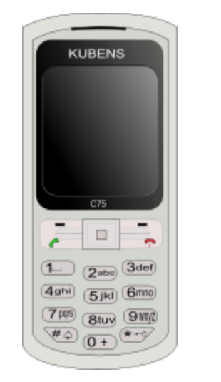
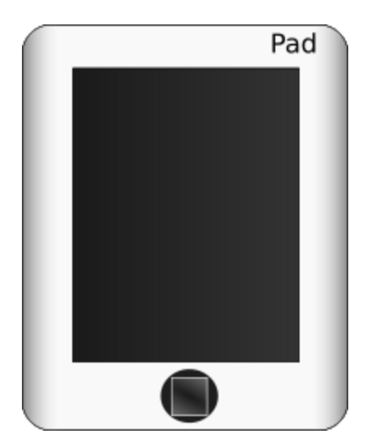
What is a Computer ?
A computer is a general purpose device that can be programmed to process
information, and yield meaningful results.

Slide 5
How does it work ?
Information
store
Program
Computer
results
Program – List of instructions given to the computer
Information store – data, images, files, videos
Computer – Process the information store according to the instructions in the program

Slide 6
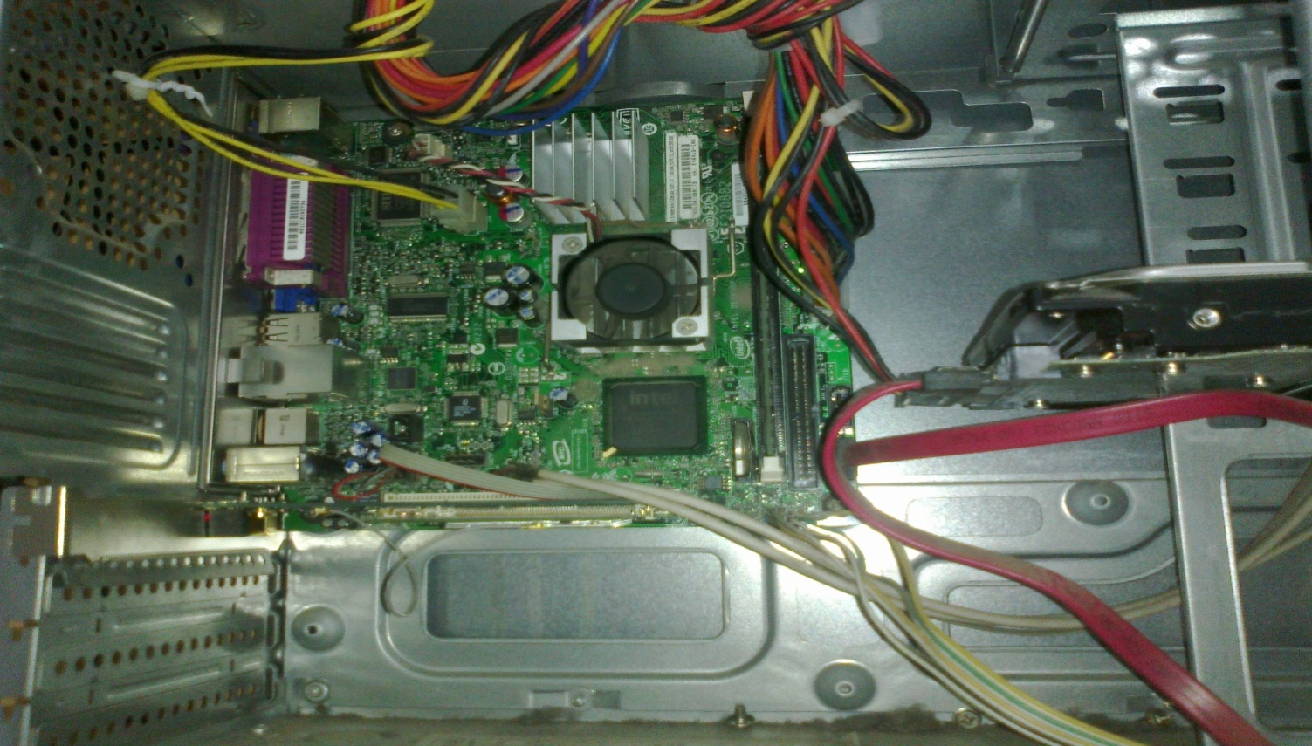
What does a computer look like ?
Let us take the lid off a desktop computer
CPU
Hard disk
Memory

Slide 7
Memory
Hard disk
CPU
Memory – Stores programs and data. Gets destroyed when the computer is powered off
Hard disk – stores programs/data permanently

Slide 8
Let us make it a full system ...
Memory
Hard disk
CPU
Keyboard
Monitor
Mouse
Printer

Slide 9

Food for Thought...
What is the most intelligent computer ?

Slide 10
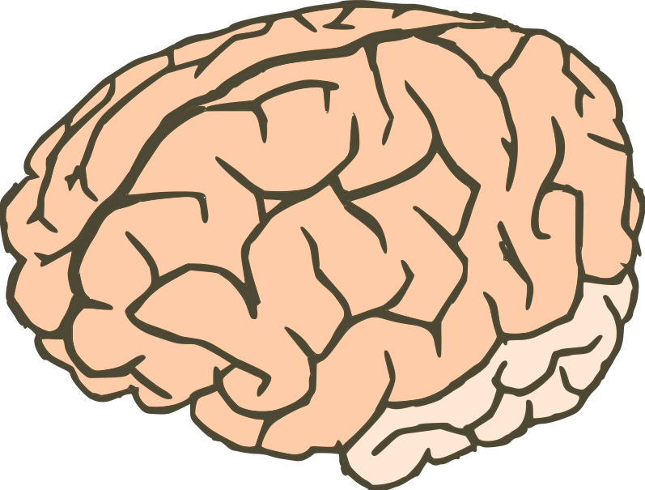
Answer ...
Our brilliant brains

Slide 11
How does an Electronic Computer Differ from our Brain ?
Feature
Computer
Our Brilliant Brain
Intelligence
Dumb
Intelligent
Speed of basic calculations
Ultra-fast
Slow
Can get tired
Never
After sometime
Can get bored
Never
Almost always
Computers are ultra-fast and ultra-dumb

Slide 12
Books
Text Books:
Mano, Morris M., Computer System Architecture, Prentice Hall (1991) 3rd ed.
Hayes, J.P., Computer Architecture and Organization, McGraw Hill (1998) 3rd ed.
Reference Books:
Hennessy, J.L., Patterson, D.A, and Goldberg, D., Computer Architecture A Quantitative Approach, Pearson Education Asia (2006) 4th ed.
Leigh, W.E. and Ali, D.L., System Architecture: software and hardware concepts, South Wester Publishing Co. (2000) 2nd ed.

Slide 13


